Slide 1
REACT HOOKS

Slide 2
Hook is a special function that let you “hook into” react feature

Slide 3
RULES OF USING HOOK
Always write it inside the component or function
Component name must be pascalcase (first letter should be uppercase)
We can directly import or we can directly write it using React.Hookname.
Don’t call hooks inside loops, conditions, or nested functions.

Slide 4
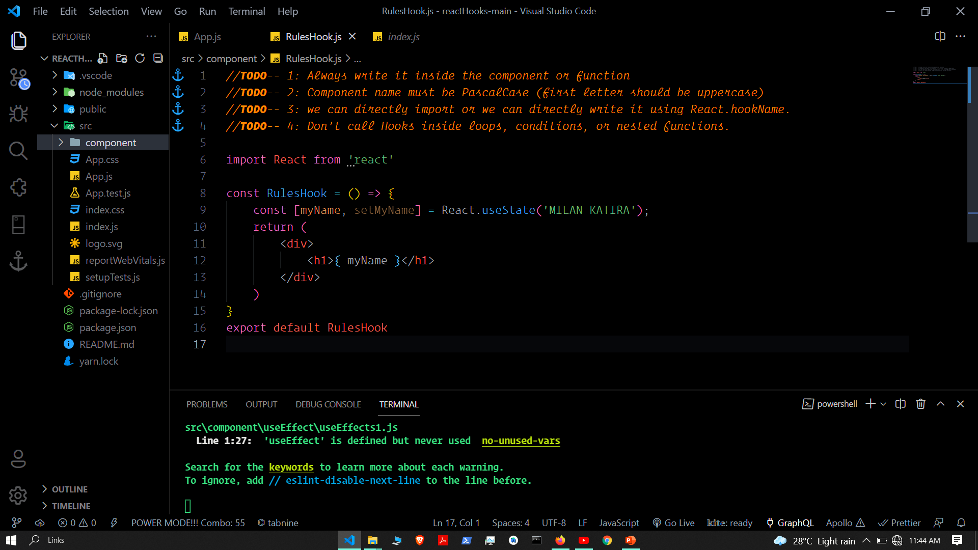

Slide 5
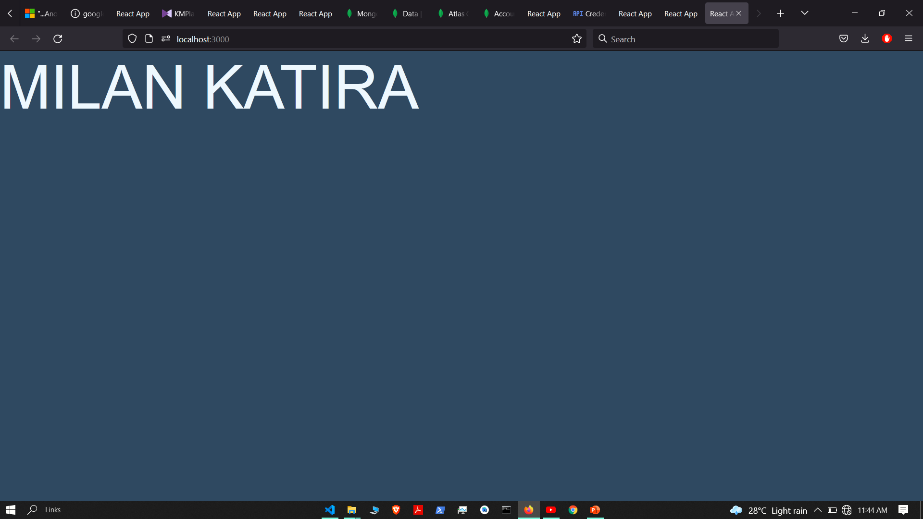

Slide 6
UseState hook

Slide 7
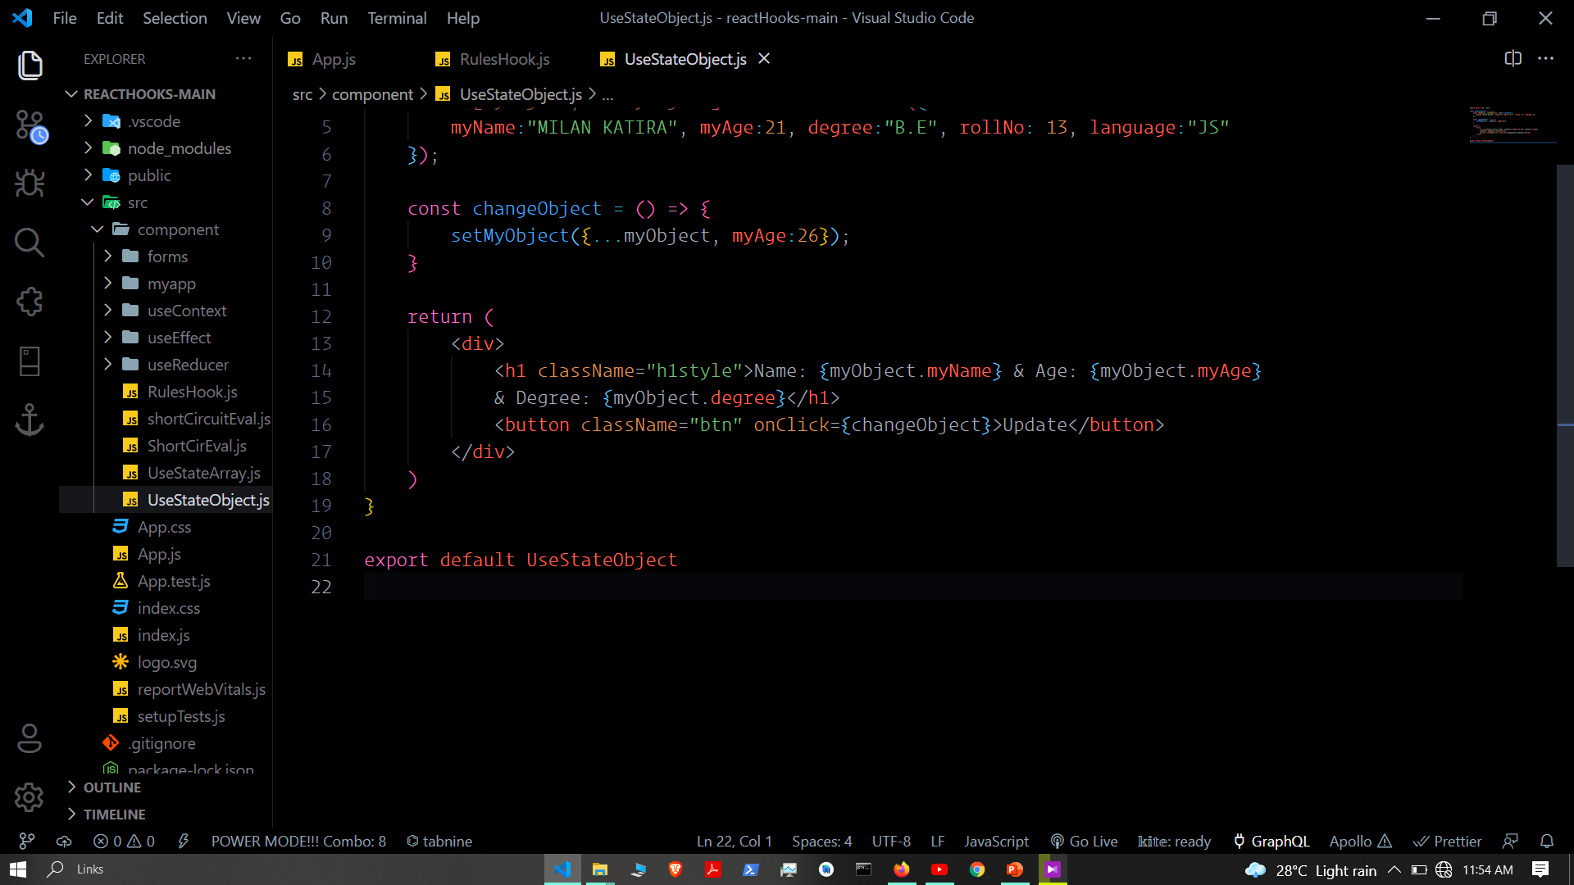

Slide 8
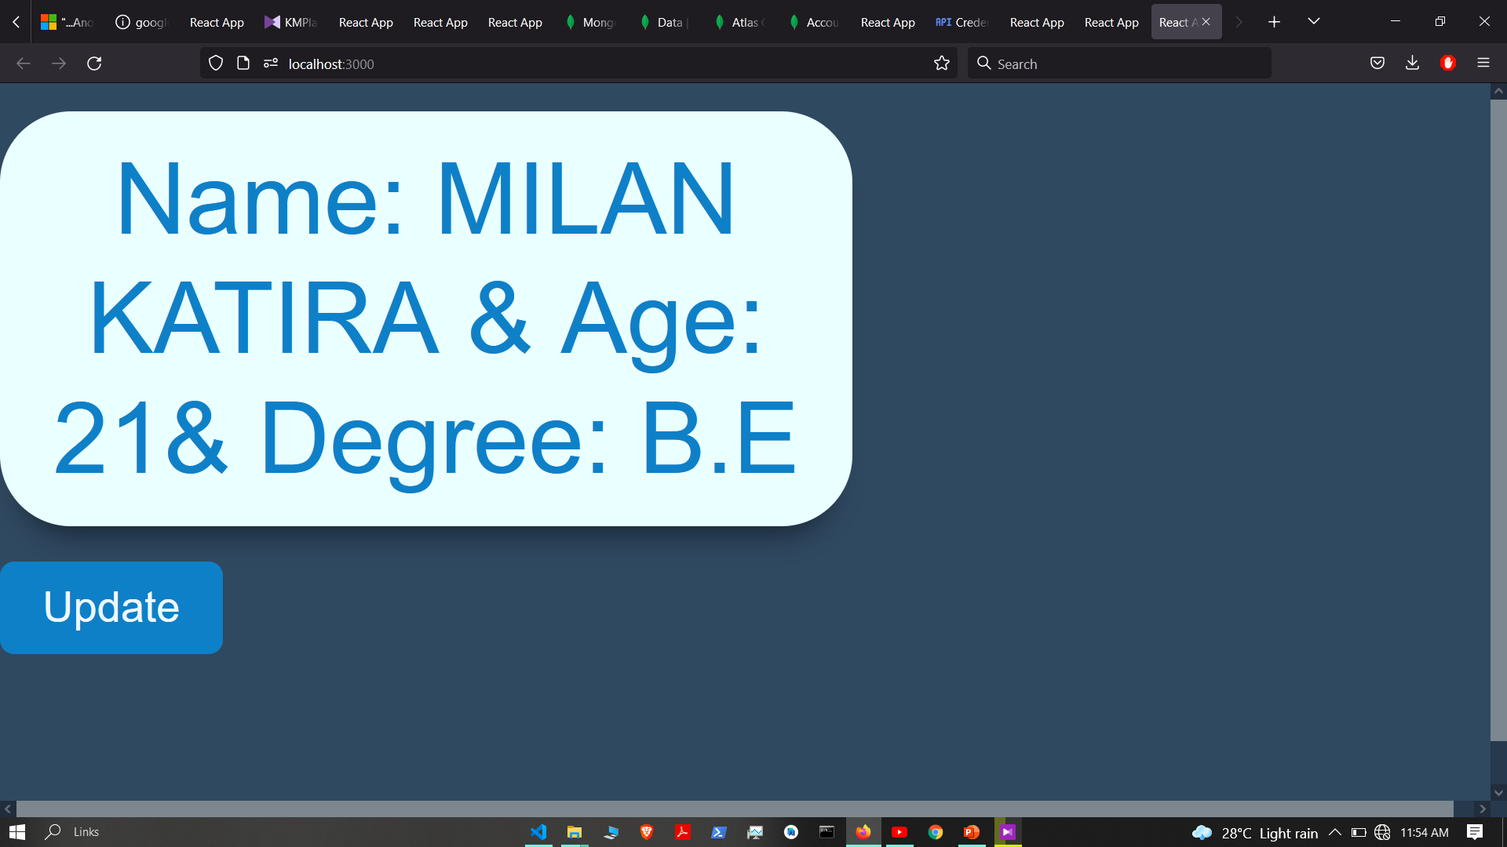

Slide 9


Slide 10
Short Circuit evolution

Slide 11
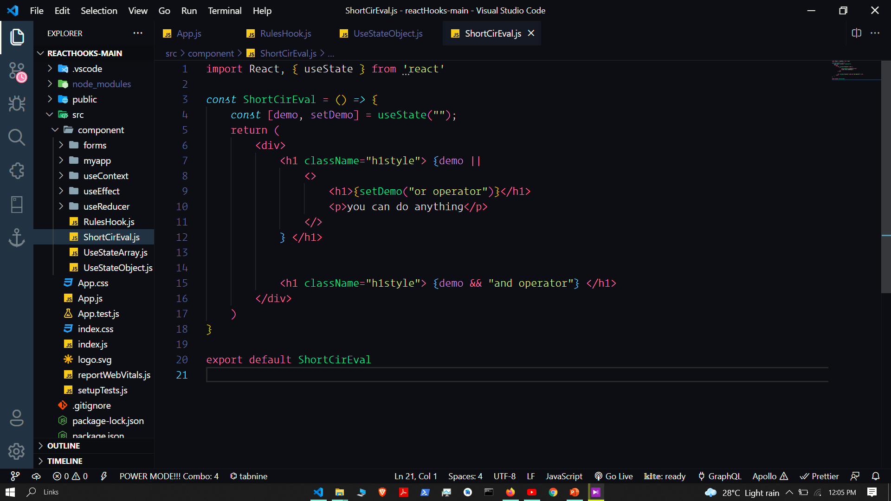

Slide 12
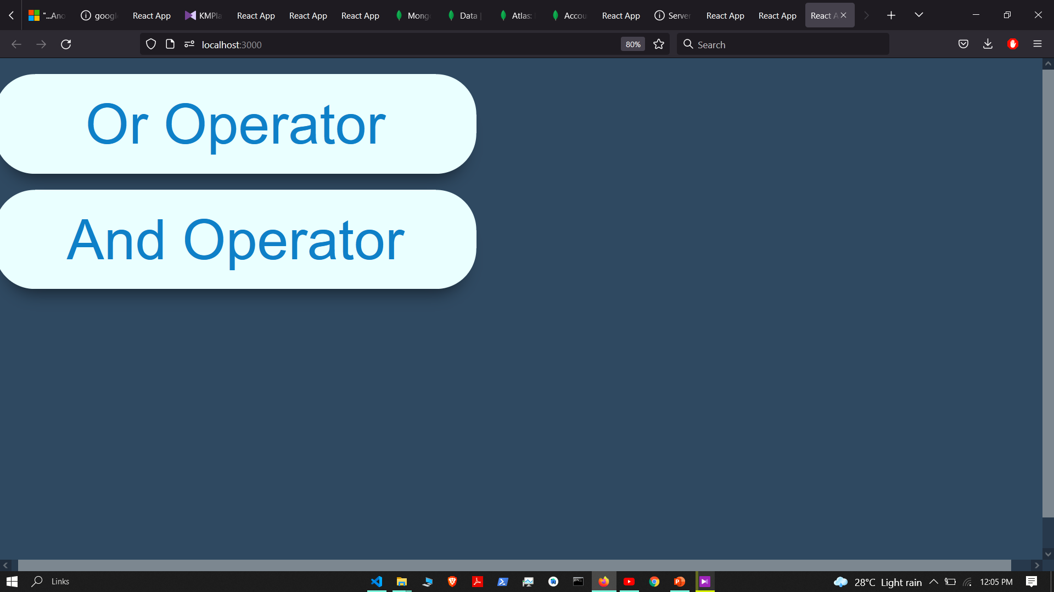

Slide 13
Form validation

Slide 14
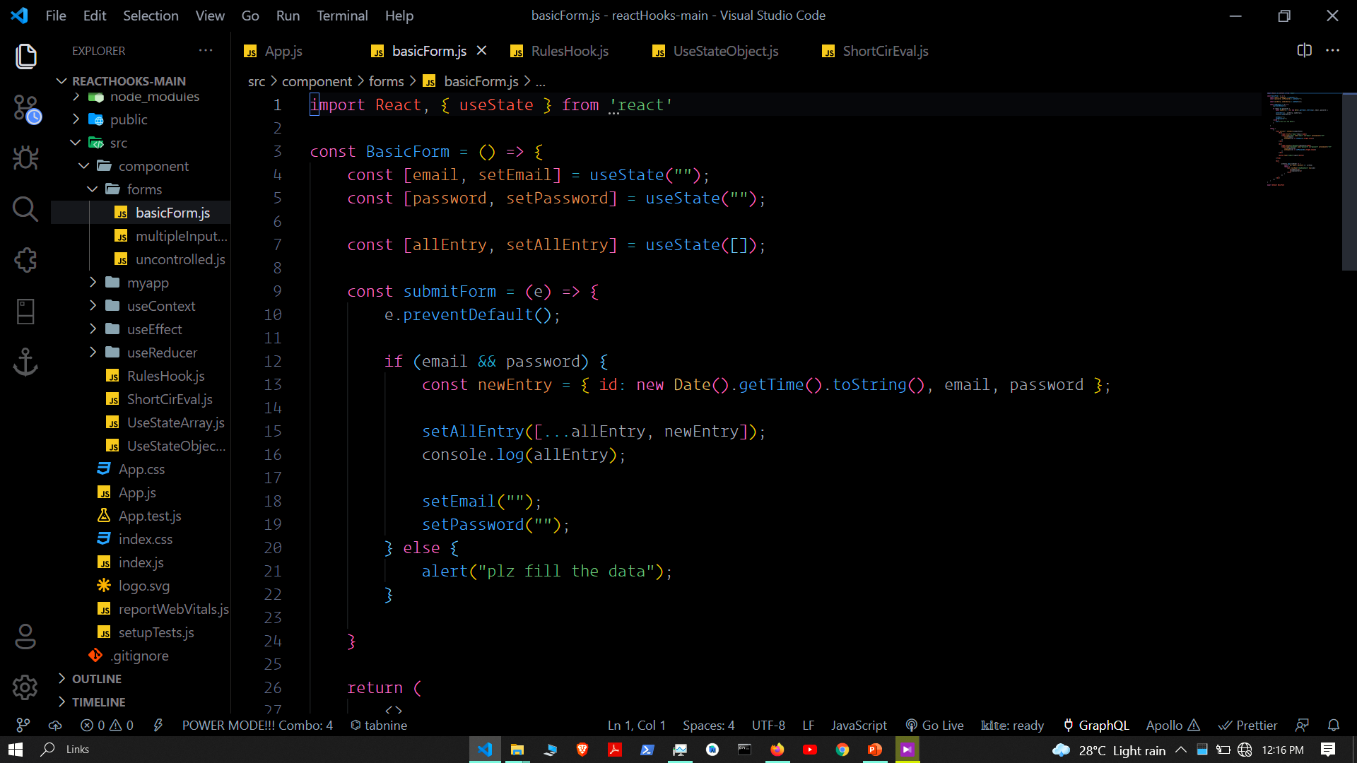

Slide 15
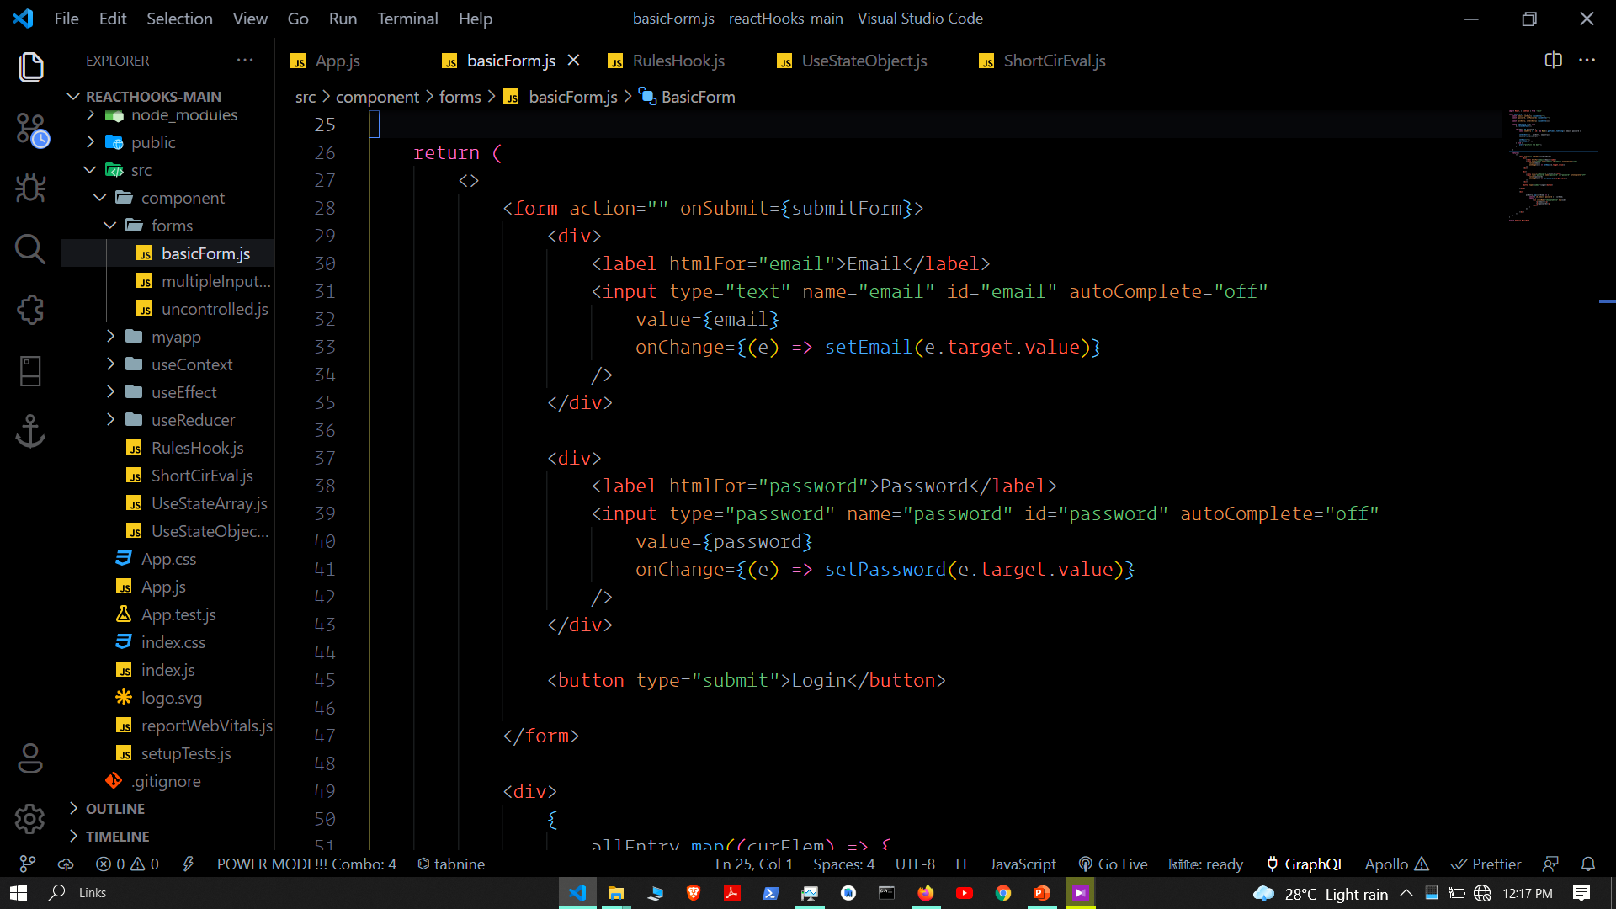

Slide 16
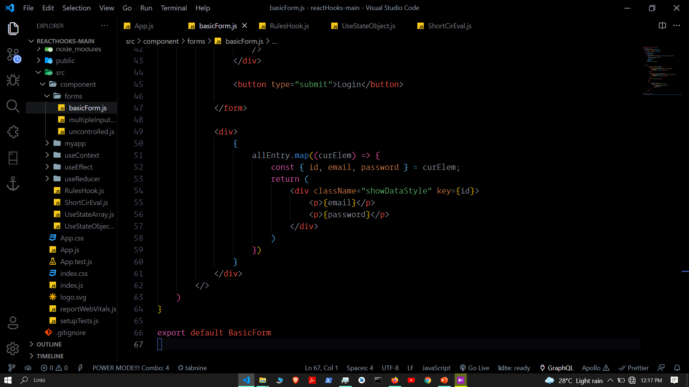

Slide 17
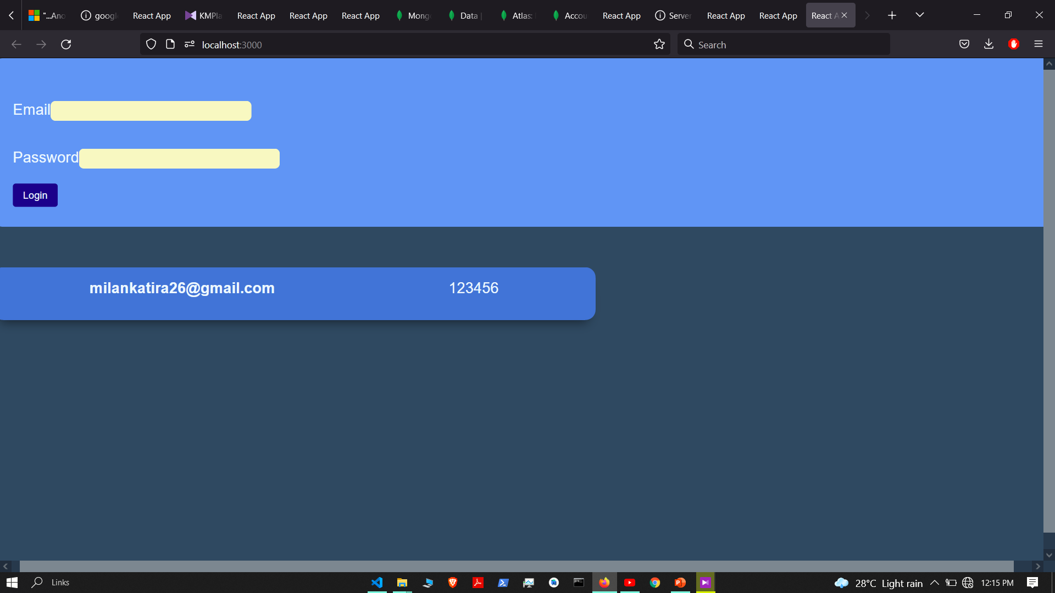

Slide 18
UseEffect hook

Slide 19
Use effect hook let you perform side effect in functional components

Slide 20
What is side effect
Side effects are basically anything that affects something outside of the scope of the current function that’s being executed. In our dashboard, this includes:
API requests to our backend service
Calls to our authentication service
Error tracking calls to Sentry

Slide 21
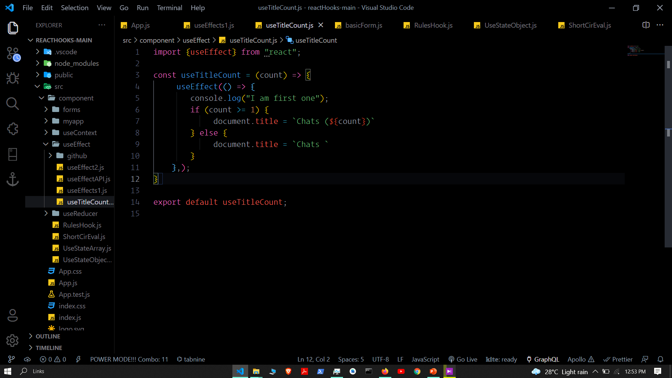

Slide 22
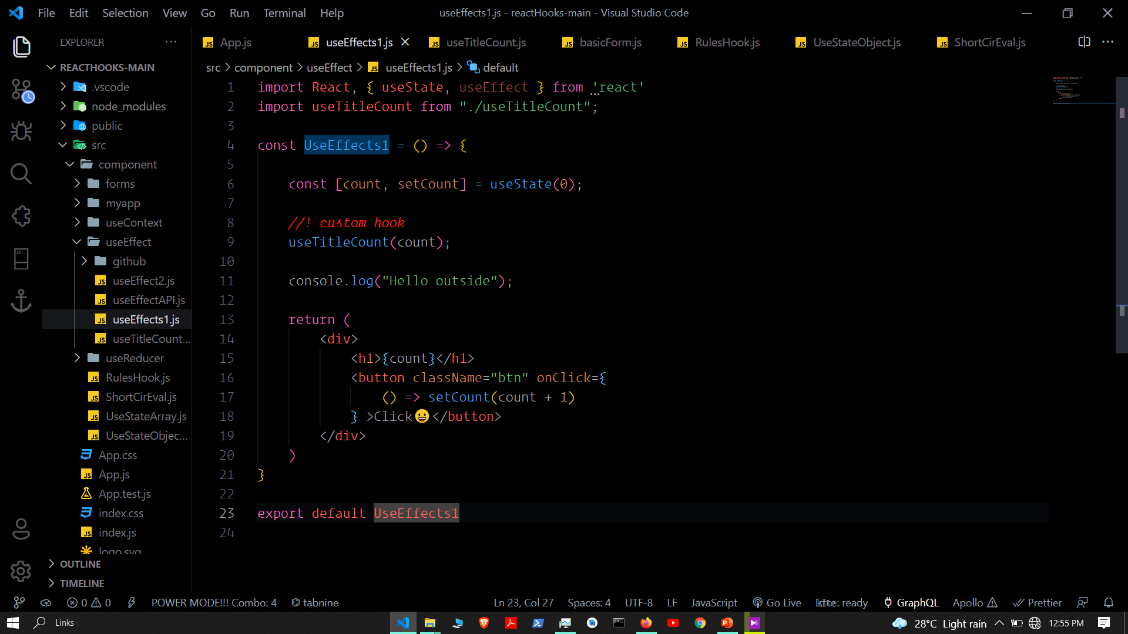

Slide 23
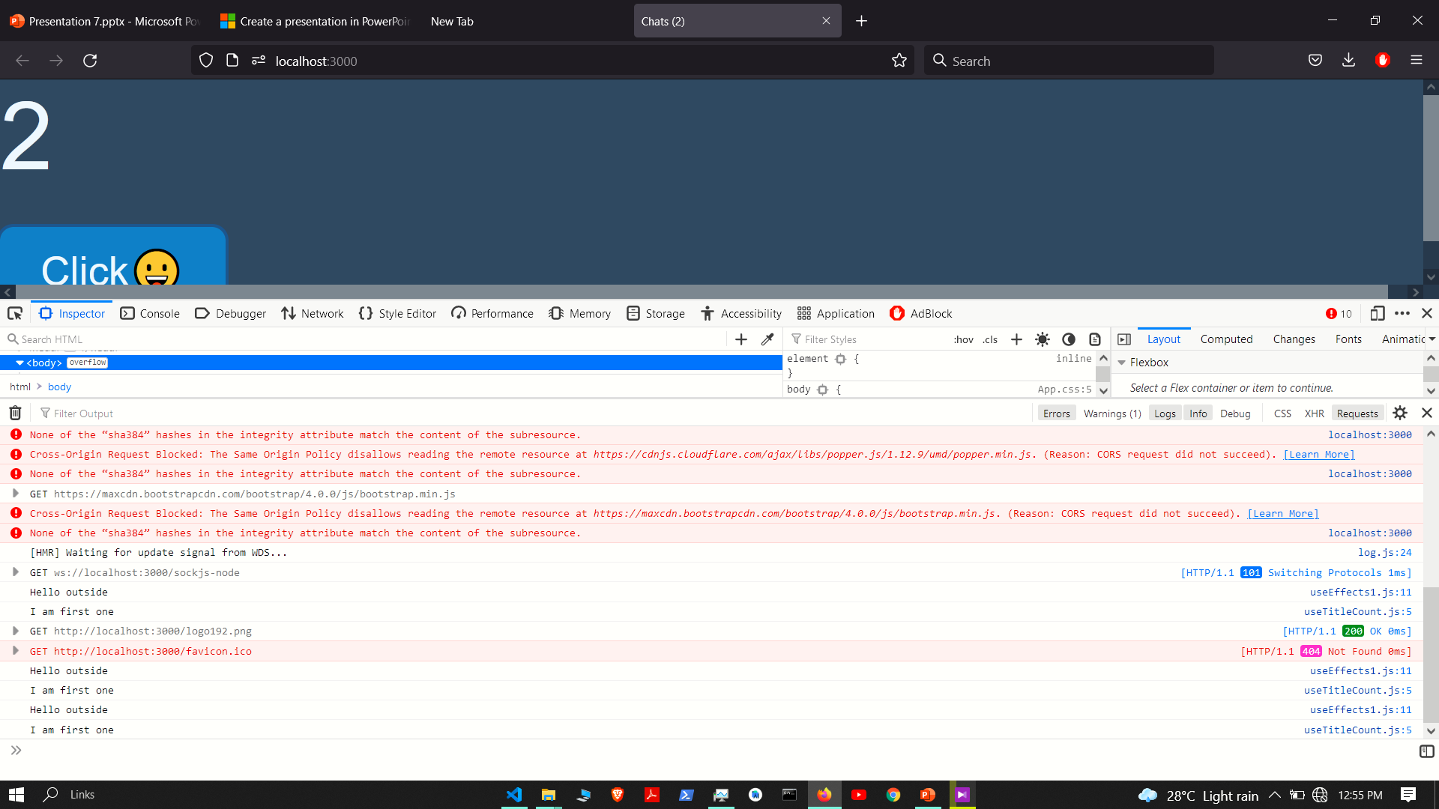

Slide 24
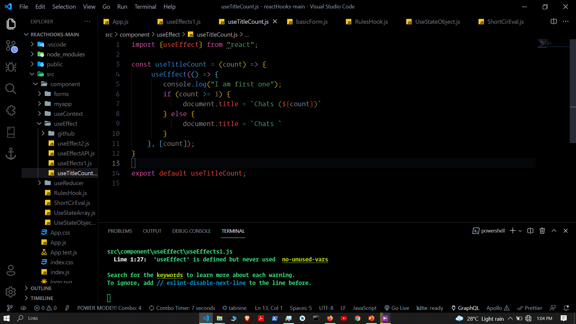
Dependency array

Slide 25
Clean up function

Slide 26
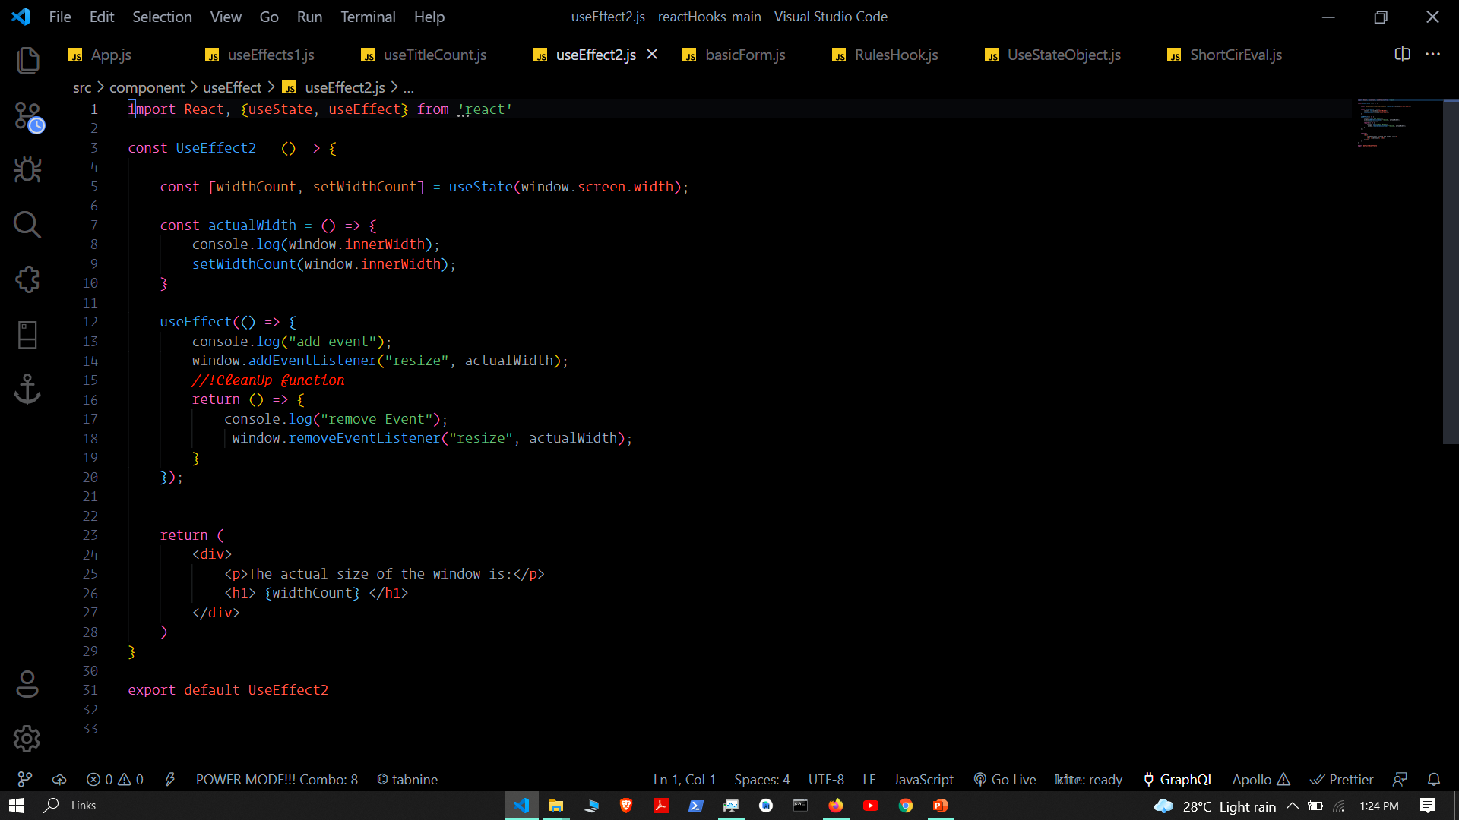

Slide 27
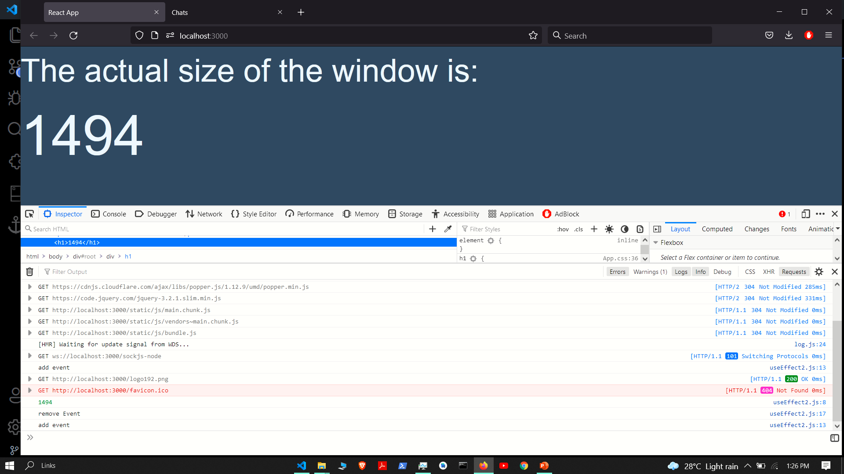

Slide 28
UseReducer hook

Slide 29
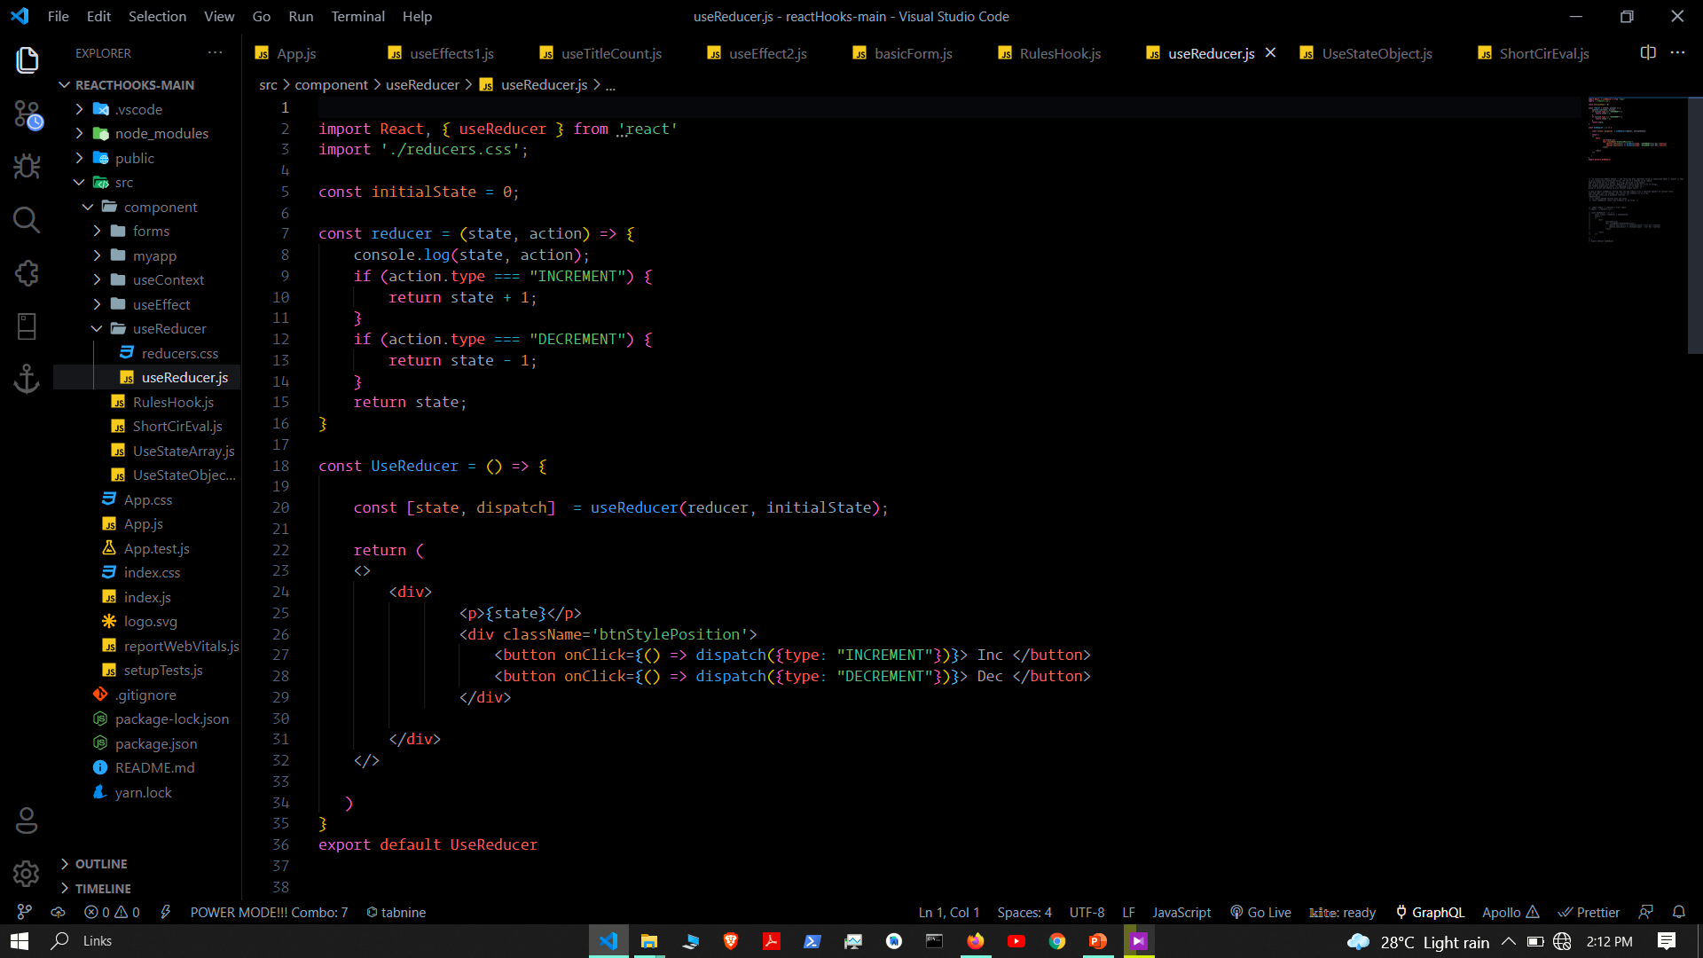

Slide 30
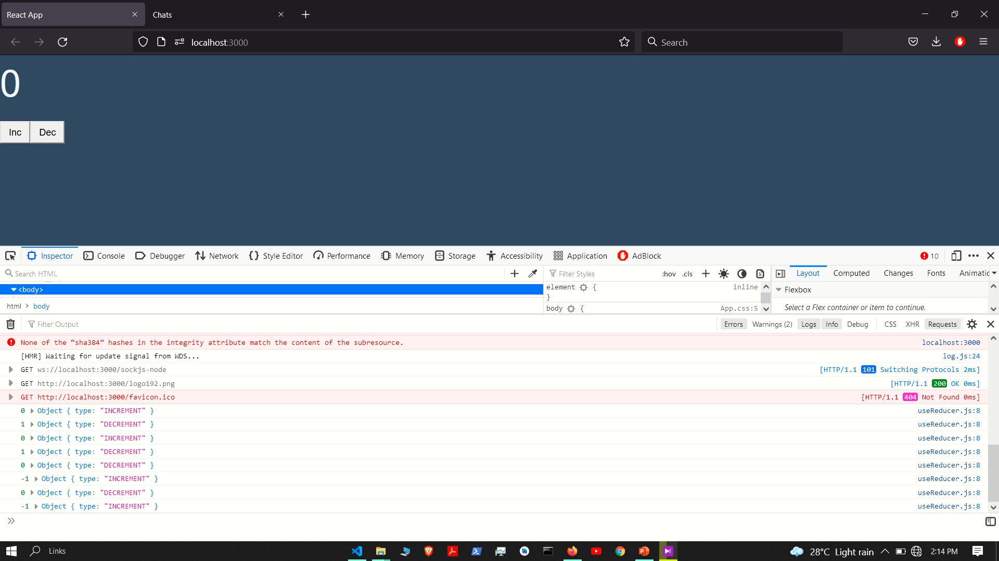

Slide 31
Use context hook

Slide 32
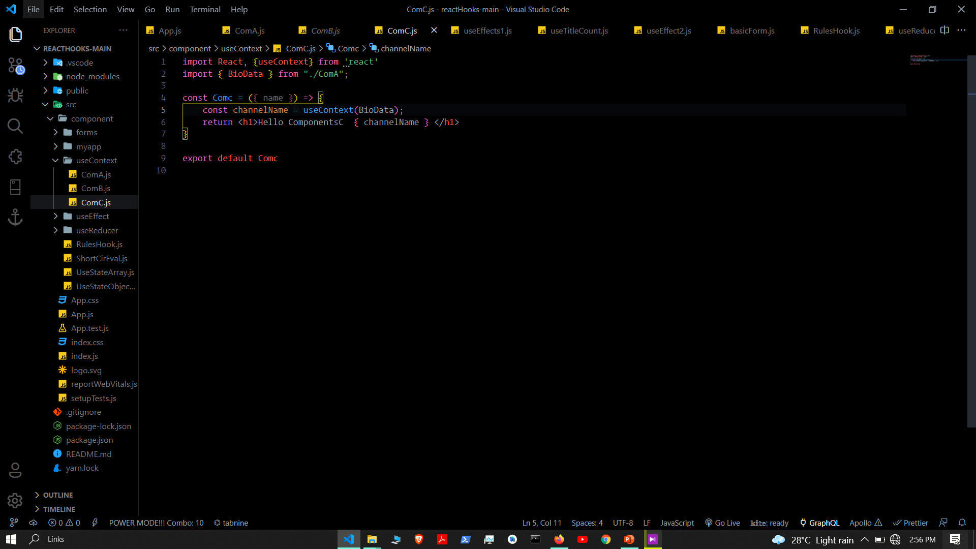

Slide 33
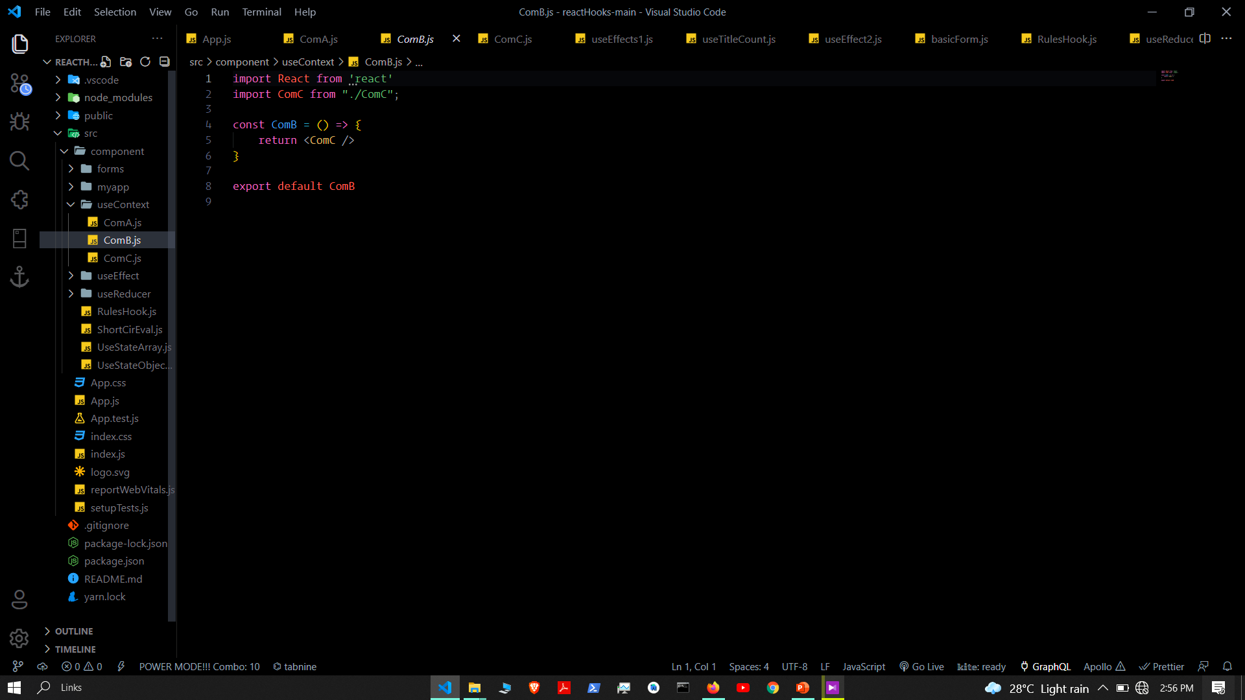

Slide 34
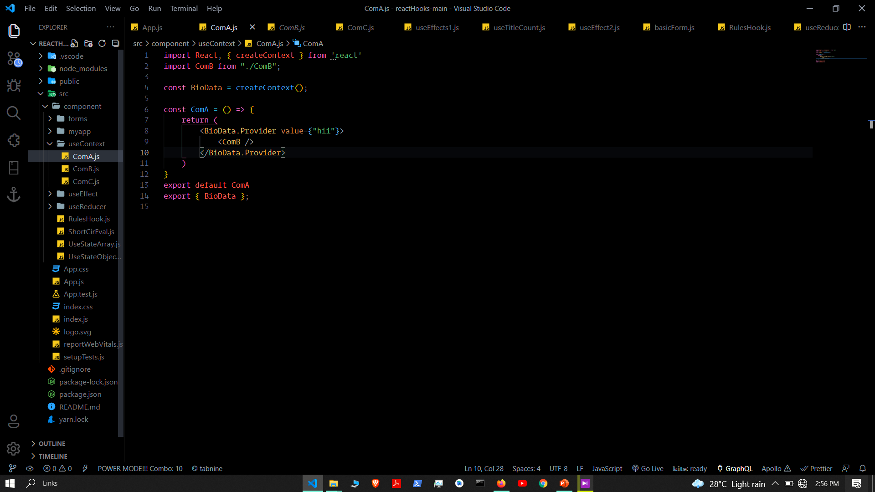

Slide 35
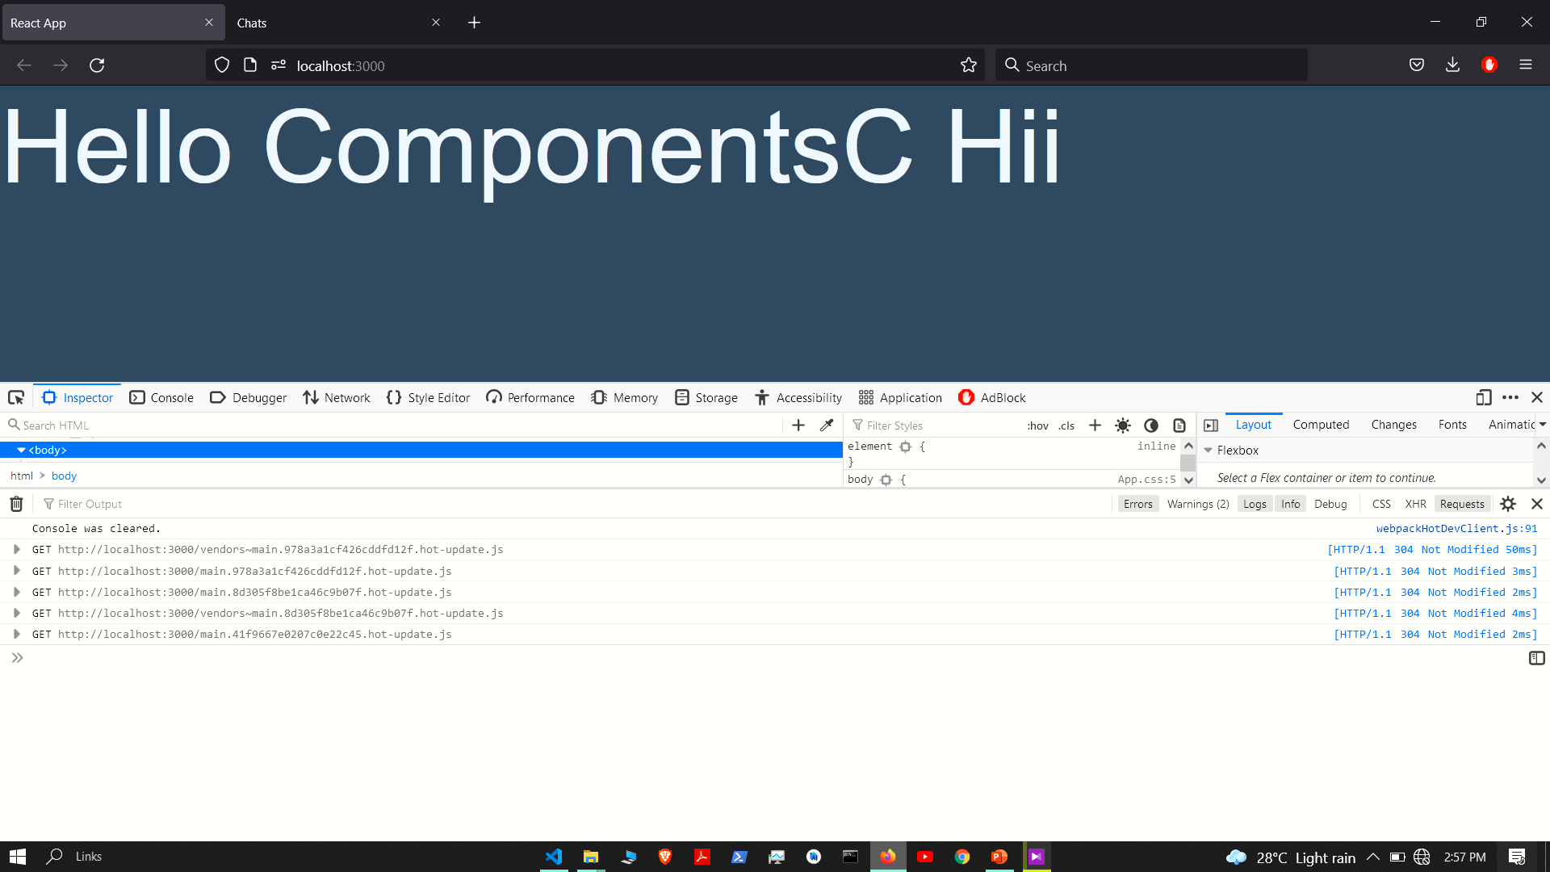

Slide 36
Use Location hook and use history hook

Slide 37
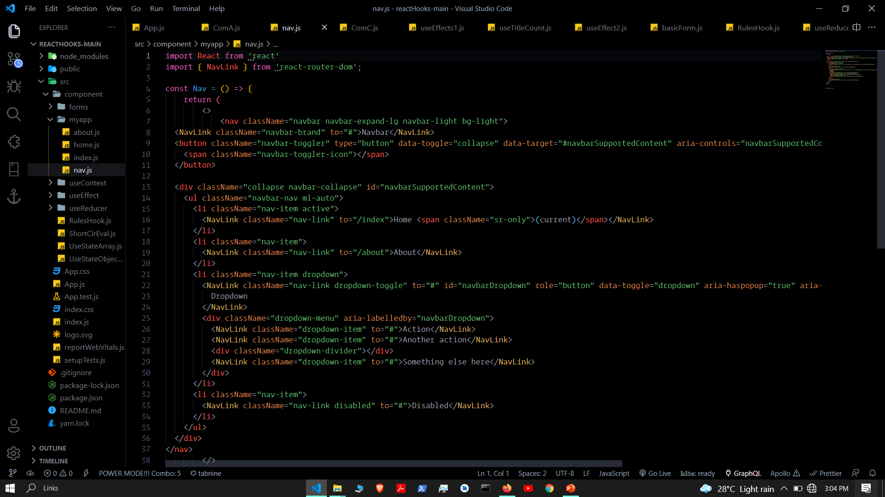

Slide 38
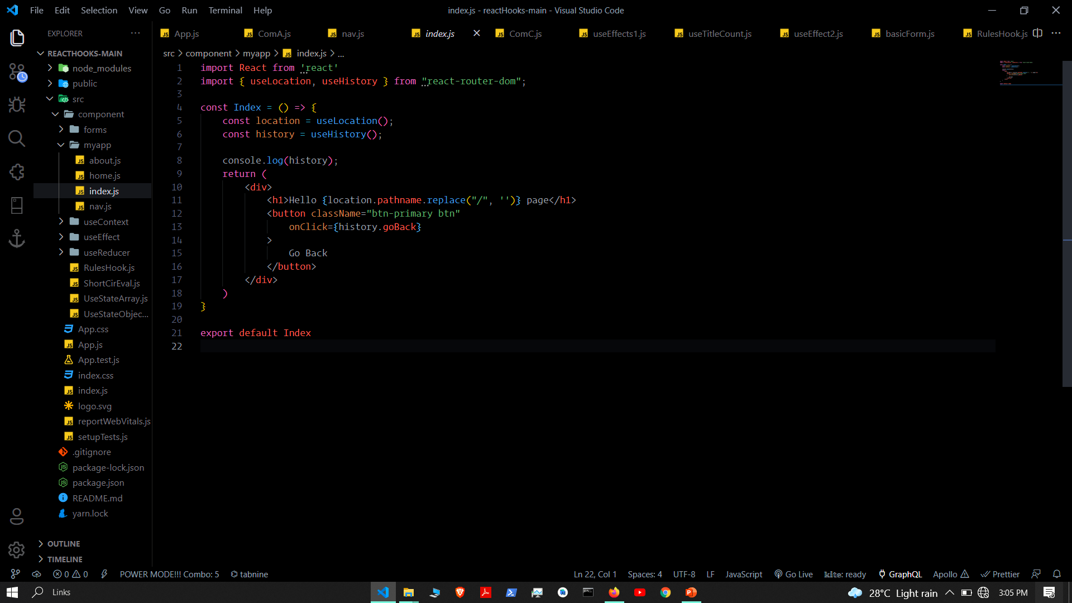

Slide 39
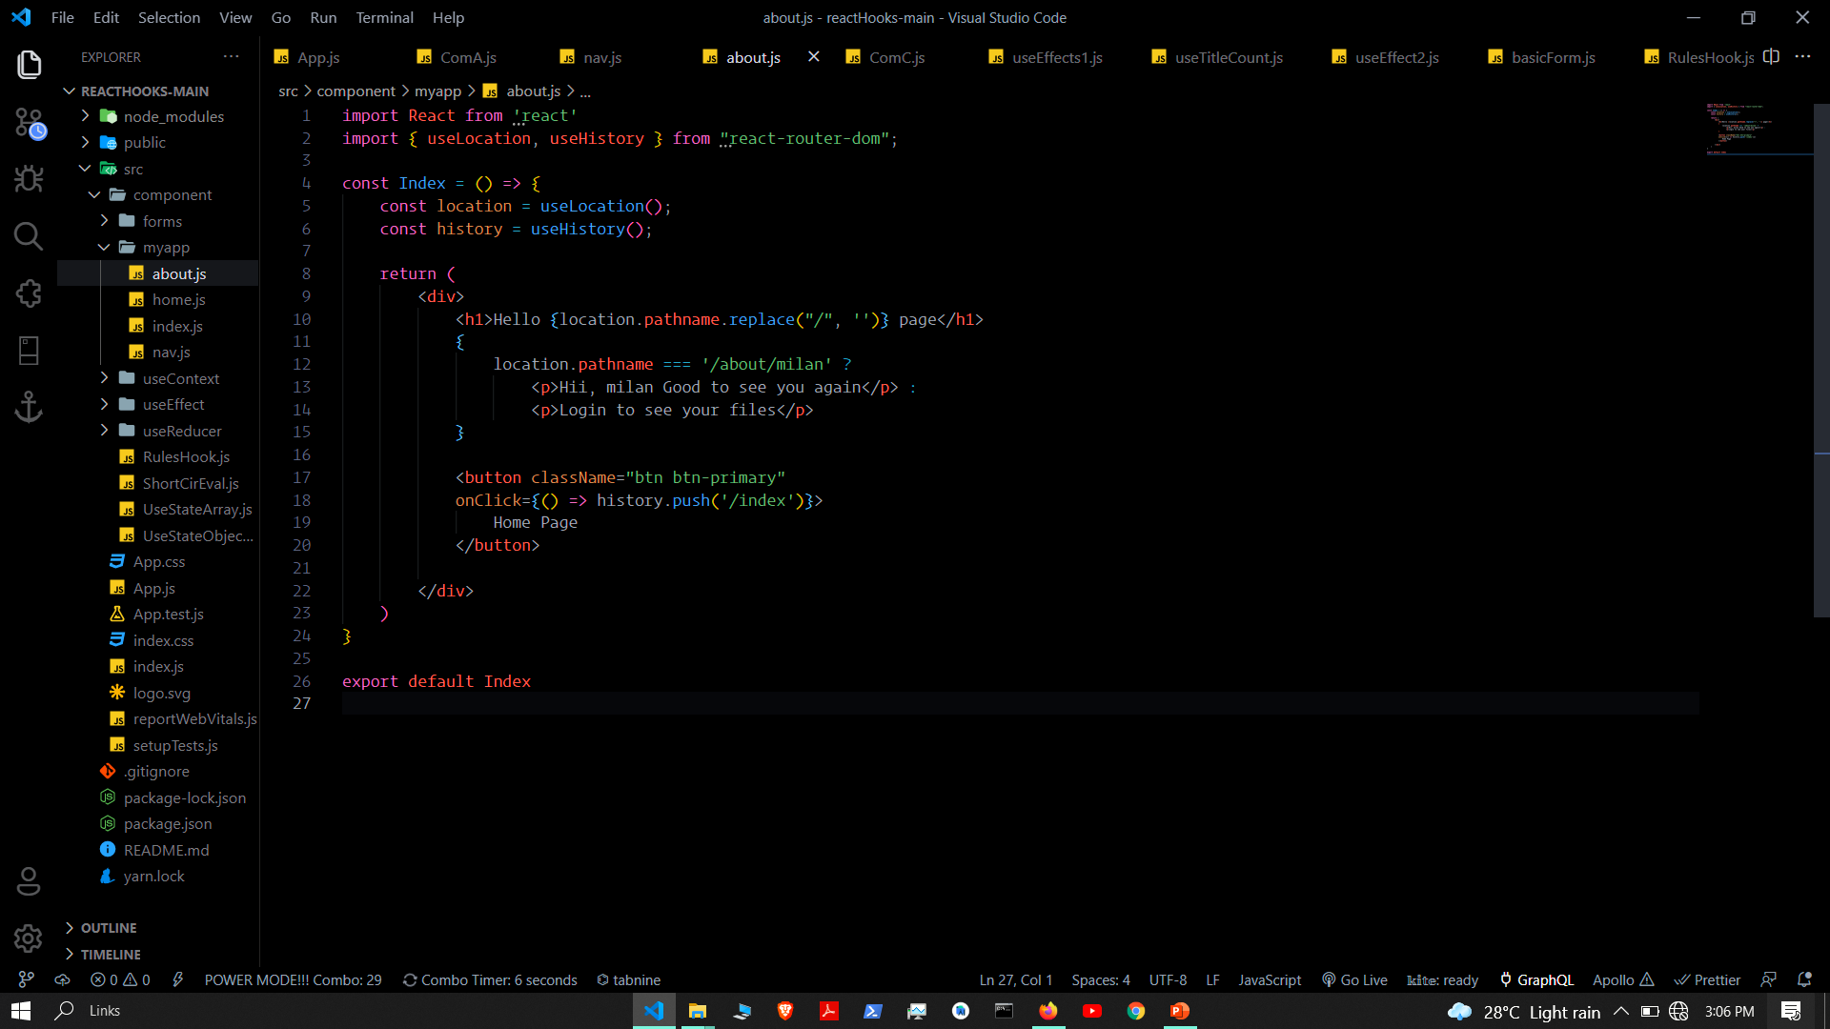

Slide 40
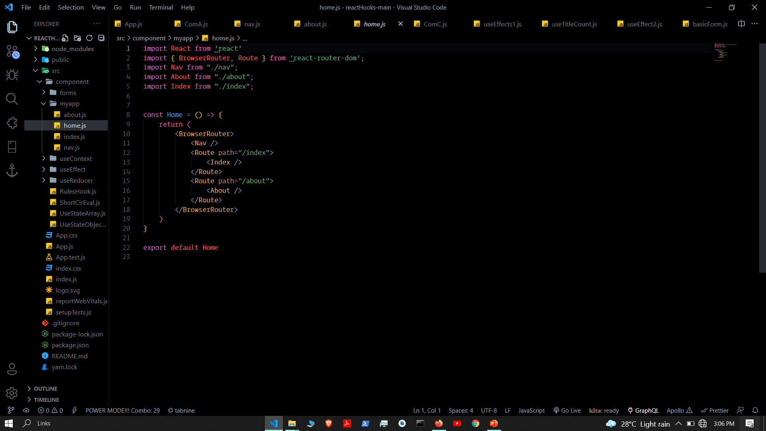

Slide 41
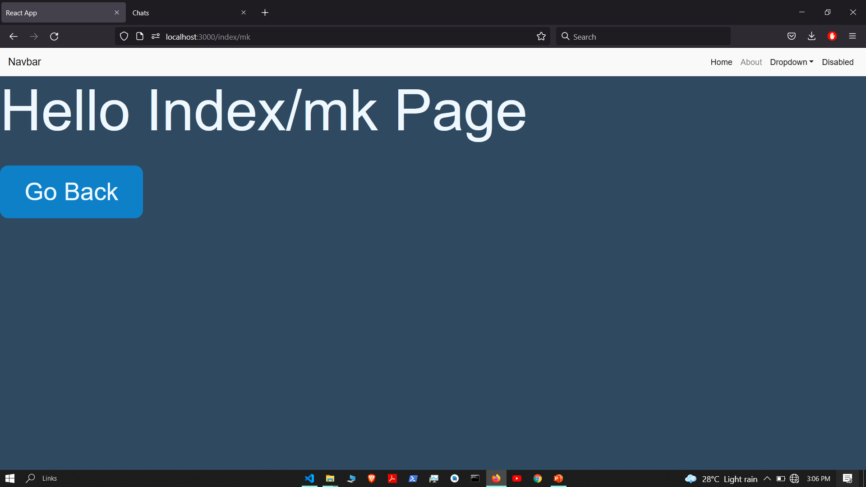

Slide 42
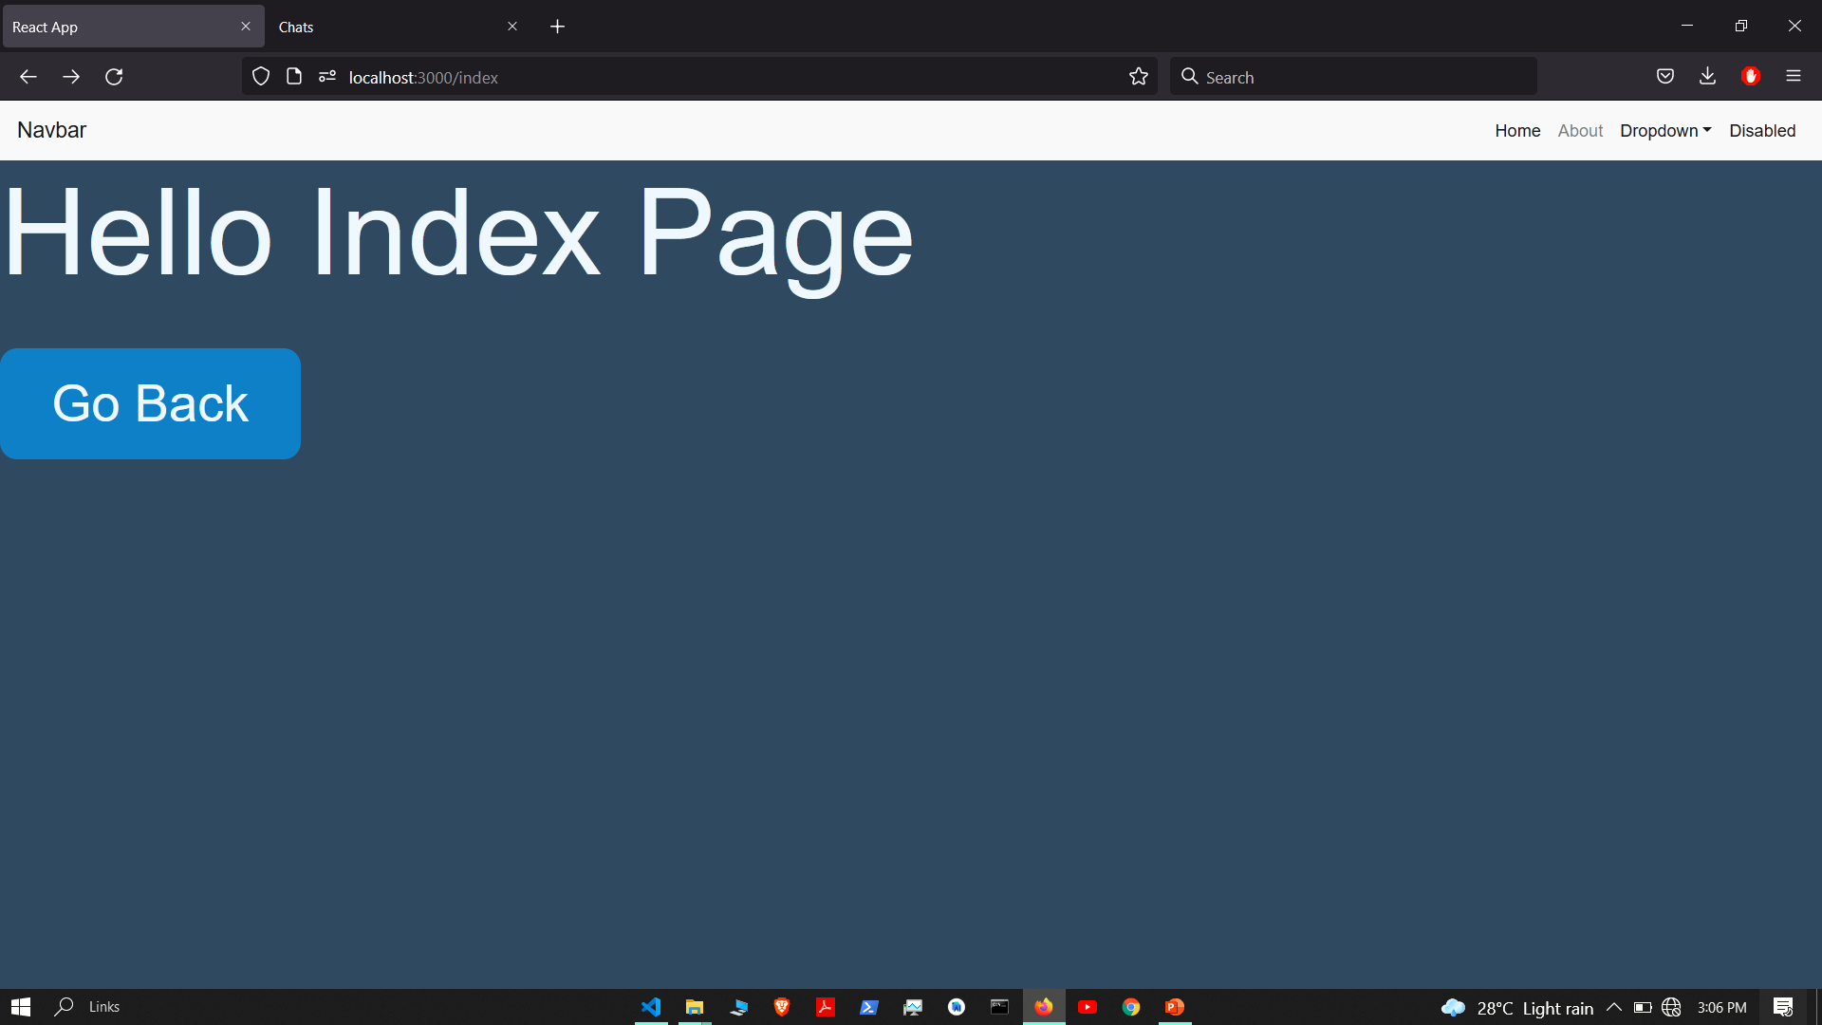

Slide 43
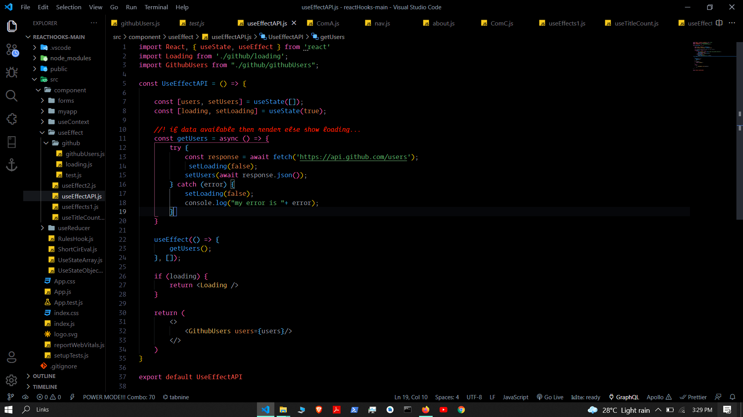

Slide 44
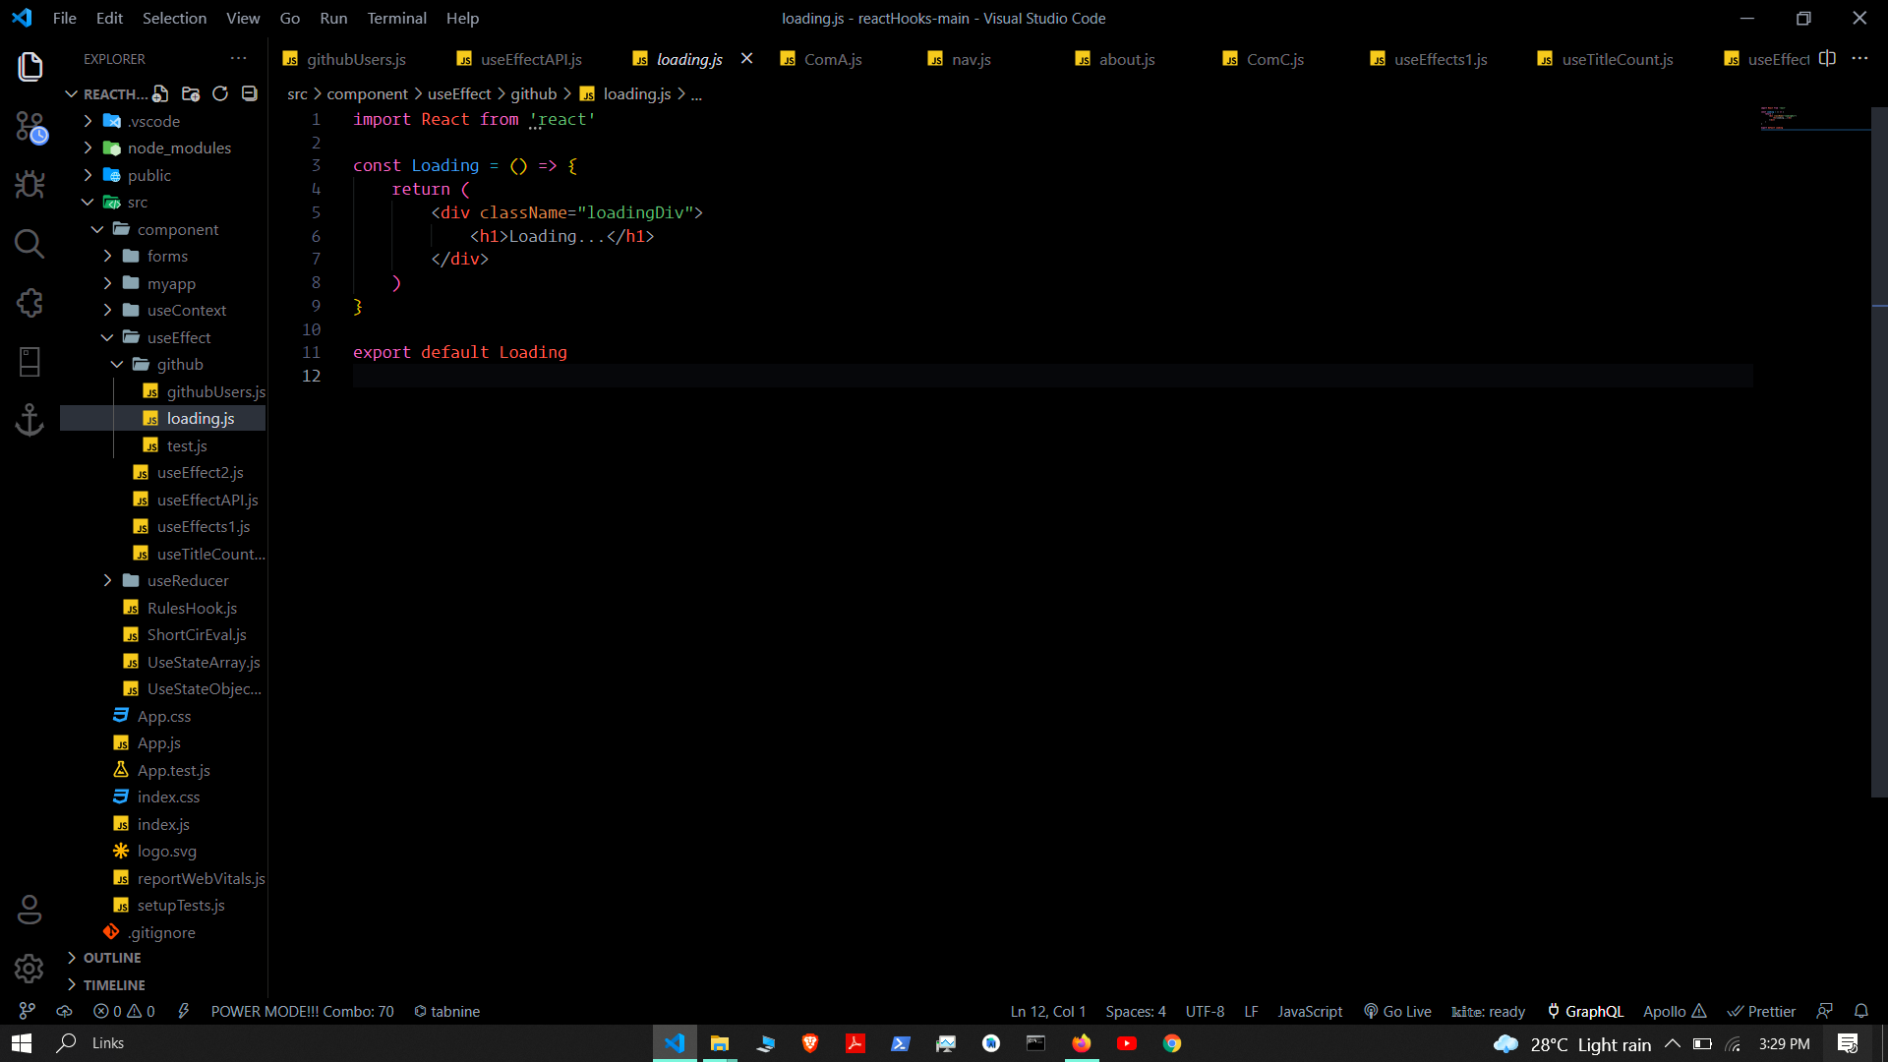

Slide 45
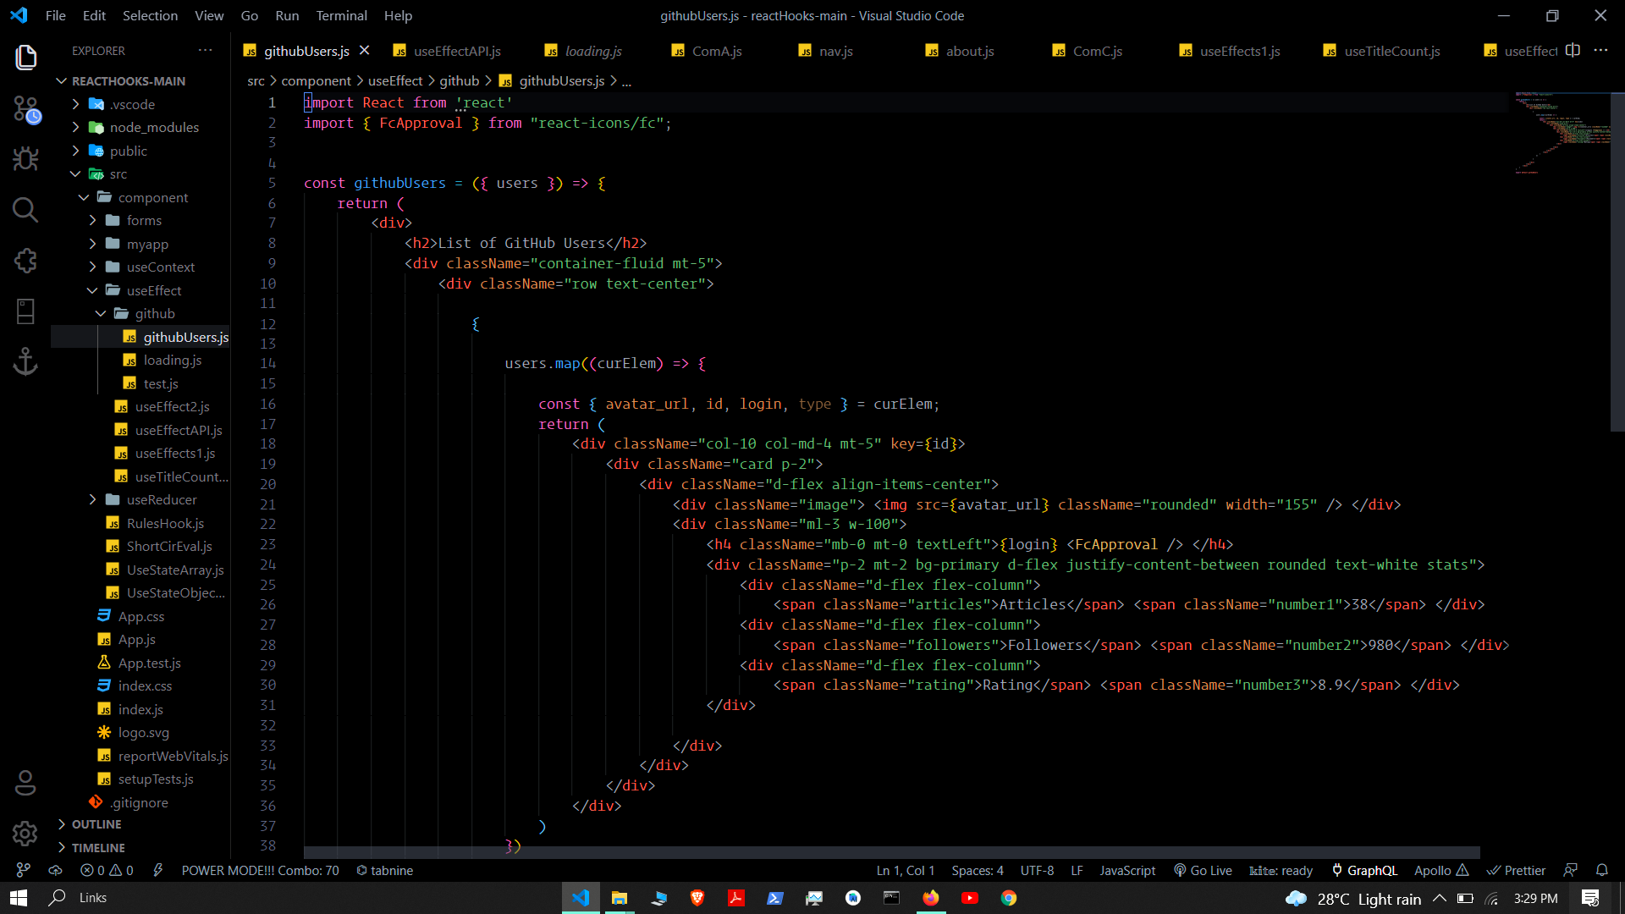

Slide 46
